Slide 1


GS Quantify 2019 Lining up Logs
Name – Shankar Lal
College – IIT Madras

Slide 2
EDA
Model
Prediction
Word Embedding
Pre-processing
Split the text into Line Number and logs
Word Cloud of Words before any pre-processing
Frequency distribution of words before any pre-processing
Removal of HTML characters
Eliminate punctuations and special characters
Fetching out only ASCII characters
Removing short words (length >2) and lemmatizing the words
Frequency based numeric vector representations of words
Extracting unique words from text by using Bag of Words approach
Elbow method is used to find optimal cluster ranging from 5 to 20
Optimal number of clusters are selected 17 from elbow plot
K – Means clustering algorithm is used to cluster the training dataset into 17 groups with labels from C1 to C17
Labelled data (from k-means clustering result) is splitted into 80% training and 20% validation
KNN is used by taking 10 nearest neighbours into an one class and predicted valid data with 0.96 F1 score
High score to importance words rather than the most frequent words which do not contain any significance, TF-IDF

Slide 3
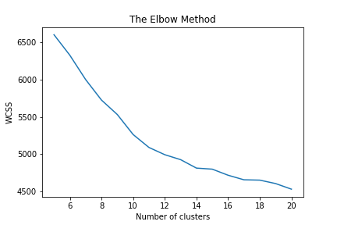
gs.api.log.90_Sep 03, 2019_12:11:00 67404 INFO gs.resource.resource_tracker [ req-sngw-07c3-13a09 ] "GET /v2/1vne30u7kqsigojy/servers/details HTTP/1.1" status: 202 len: 9339 time: 0.5309531
Outcomes
Limitations
Word Embeddings
Model Building
BoW and TF-IDF don’t respect semantics of the word
Curse of dimensionality issue
Assumes that counts of different words provide independent evidence of similarity
Term ordering is not considered
Starts with random choice of cluster centers and sensitive to local optimal
Scaling with number of dimensions
Produce clusters with relatively uniform size
Variance is not worth minimizing because it depends on the cluster
Cluster | Top 10 words
1 | Compute, meta, status, len, time, http, data, mapping, block, device
3 | Resource, tracker, claim, compute, log, info, sep, api, stopped, paused
5 | Server, status, time, len, http, api, sep, info, log, post

Slide 4
Alternate solution/Future work
Removal of most frequent and unwanted words like “len, time, http, sep etc”.
Removal of stop words from text (trial)
Use prediction based word embedding like Word2Vec which captures similar words appearing in the similar context tend to have similar embeddings
Try pre trained word embeddings like “Glove, ConcepNumberBatch, FastText etc” which takes words and context into a picture for better representation of word
To reduce training complexity of model and high dimensional space problem try PCA and SVD
Gaussian Mixture Model (GMM) and Density based Spatial clustering applications with Noise instead of K-Means clustering algorithm with silhouette score for training and as well as for prediction
Experiment-
Use labelled training data (after clustering) to predict the cluster class of unseen logs by using KNN, Tree based models.

Slide 5
Thank you!
…and now YOUR questions?

